Slide 1
Allocation Rate Optimization
Understand who and

Slide 2
We defined problematic areas with the Bookings and Unallocation Rate quadrant, where we put each areas (Both PU and Dropoff) in the quadrant then prioritize.
Analysis Framework
Problem Identifications
% Unallocated
Optimize Last
High Unallocated
but low bookings
Even if we increase the allocation rate here, the weighted allocation rate will not significantly improve
Dying
High Unallocated
High bookings
Areas in this quadrant have a high contribution toward overall Allocation Rate
Framework
Self-Sustain
Low Unallocated
low bookings
For now, we don’t have to worry about this quadrant since they have a relatively low bookings contribution and already have a good allocation rate
Role Models
Low Unallocated
High bookings
This area are the one that keep the overall Allocation Rate high
Data Analysis
Proposal And Simulation
# Bookings
Notes:
Defined if the unallocation rate is below the dataset unallocation rate: ~27%
Allocation Rate is calculated by # Bookings with Candidates divided by # Bookings.

Slide 3
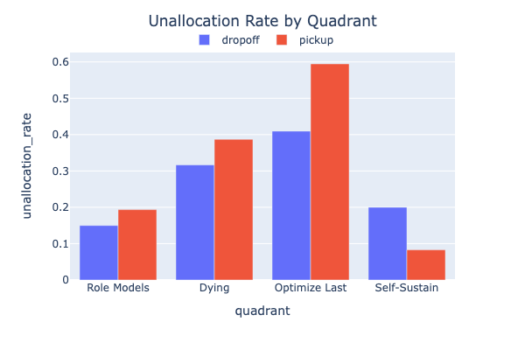
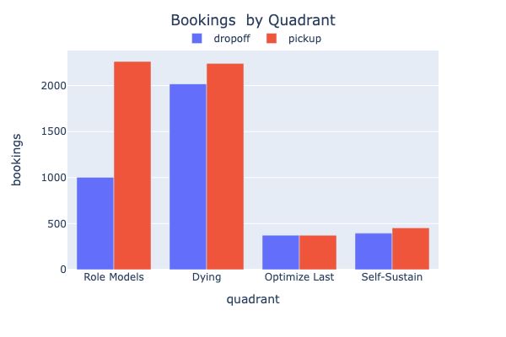


To further understand why we’re using the framework is depicted in this visualization.
We defined problematic areas with the Bookings and Unallocation Rate quadrant, where we put each areas (Both PU and Dropoff) in the quadrant then prioritize.
% Unallocated
Optimize Last
High Unallocated
but low bookings
Dying
High Unallocated
High bookings
Here’s where we need to focus our effort,
since areas in this quadrant have a high contribution toward overall Allocation Rate, improving this area will have a higher probability to increase the overall allocation rate
Calculating the impact toward 10% improvement in un-allocation rates, the Dying Quadrant could yield highest impact
Self-Sustain
Low Unallocated
low bookings
Role Models
Low Unallocated
High bookings
We could try to move some drivers from this area to areas in Dying Quadrant (need to experiment to ensure that by doing so it doesn’t affect this area negatively)
Dying | 16%
Optimize Last | 3%
Role Model | 13%
Self-Sustain | 3%
# Bookings

Slide 4
Potential Levers that could be done to move drivers
Pricing Lever
Increase price to move drivers toward low allocation rate areas
(+) Grab doesn’t bear the cost
(+) Depending on the price elasticity, could even gain more revenue
(-) Will affect demand
Incentives Lever
Introduce Area-time based Incentives to move drivers toward low allocation rate areas
(+) Will not affect demand
(-) Grab has to bear the cost
Tactical Strategy
Manually adjust allocation or other product configurations which directly affect the way Grab Allocate to drivers (i.e.: Longer allocation time, wider allocation radius, etc.)
(+) Will not increase cost for both sides
(-) Might have an impact on customer experience

Slide 5
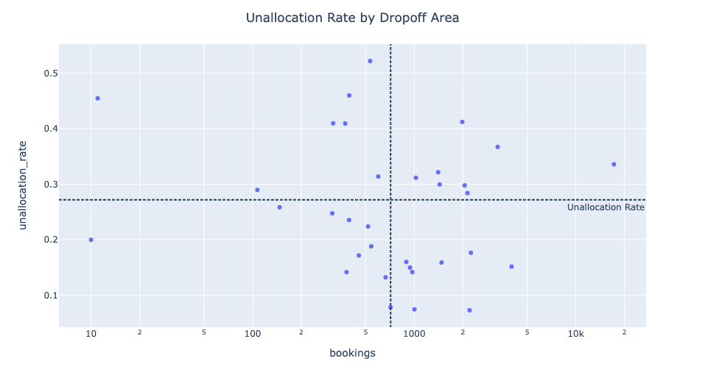
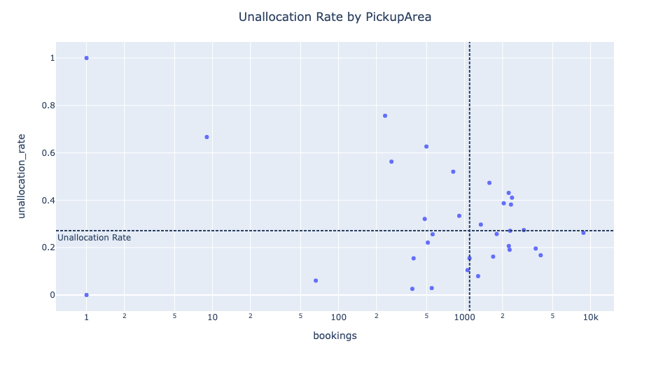
Appendix
area | distance | bookings | bids | allocated | unallocated | allocation_rate | unallocation_rate | weighted_unallocation_rate | area_type | is_high_booking | is_good_allocation | quadrant
City | 5.5255 | 8780 | 13803 | 6476 | 2304 | 0.737585421 | 0.262414579 | 0.04539812 | pickup | 1 | 1 | Role Models
Punggol/Sengkang | 14.2195 | 4018 | 8255 | 3344 | 674 | 0.832254853 | 0.167745147 | 0.013280526 | pickup | 1 | 1 | Role Models
Woodlands | 18.926 | 3667 | 7029 | 2948 | 719 | 0.803926916 | 0.196073084 | 0.014167209 | pickup | 1 | 1 | Role Models
Ang Mo Kio/Bishan | 12.426 | 2955 | 4061 | 2145 | 810 | 0.725888325 | 0.274111675 | 0.015960277 | pickup | 1 | 0 | Dying
Jurong West | 11.4 | 2245 | 4060 | 1781 | 464 | 0.793318486 | 0.206681514 | 0.009142677 | pickup | 1 | 1 | Role Models
Yishun | 18.2945 | 1686 | 3856 | 1413 | 273 | 0.838078292 | 0.161921708 | 0.005379204 | pickup | 1 | 1 | Role Models
Fort Road | 8.955 | 2278 | 3691 | 1843 | 435 | 0.80904302 | 0.19095698 | 0.00857126 | pickup | 1 | 1 | Role Models
Chua Chu Kang | 16.4785 | 2298 | 3650 | 1675 | 623 | 0.728894691 | 0.271105309 | 0.01227562 | pickup | 1 | 1 | Role Models
Bedok | 12.744 | 1281 | 3439 | 1179 | 102 | 0.920374707 | 0.079625293 | 0.002009813 | pickup | 1 | 1 | Role Models
Hougang | 12.598 | 1799 | 2710 | 1336 | 463 | 0.742634797 | 0.257365203 | 0.009122973 | pickup | 1 | 1 | Role Models
Mandai | 15.107 | 2335 | 2544 | 1444 | 891 | 0.618415418 | 0.381584582 | 0.017556304 | pickup | 1 | 0 | Dying
Upper East Coast Road | 12.1005 | 1056 | 2479 | 945 | 111 | 0.894886364 | 0.105113636 | 0.002187149 | pickup | 0 | 1 | Self-Sustain
Bukit Batok | 13.517 | 2046 | 2268 | 1254 | 792 | 0.612903226 | 0.387096774 | 0.015605604 | pickup | 1 | 0 | Dying
Jurong East | 12.765 | 2379 | 2220 | 1402 | 977 | 0.589323245 | 0.410676755 | 0.019250852 | pickup | 1 | 0 | Dying
Tiong Bahru | 8.128 | 1096 | 2140 | 926 | 170 | 0.844890511 | 0.155109489 | 0.003349688 | pickup | 1 | 1 | Role Models
Toa Payoh | 9.3205 | 2240 | 2040 | 1275 | 965 | 0.569196429 | 0.430803571 | 0.019014404 | pickup | 1 | 0 | Dying
Pasir Ris | 13.625 | 549 | 1864 | 533 | 16 | 0.970856102 | 0.029143898 | 0.000315265 | pickup | 0 | 1 | Self-Sustain
Marine Parade | 10.577 | 1346 | 1838 | 946 | 400 | 0.70282318 | 0.29717682 | 0.007881618 | pickup | 1 | 0 | Dying
Clementi | 9.2305 | 1574 | 1353 | 829 | 745 | 0.526683609 | 0.473316391 | 0.014679514 | pickup | 1 | 0 | Dying
Loyang Road | 12.971 | 385 | 1279 | 375 | 10 | 0.974025974 | 0.025974026 | 0.00019704 | pickup | 0 | 1 | Self-Sustain
Queenstown | 10.572 | 907 | 1044 | 604 | 303 | 0.665931643 | 0.334068357 | 0.005970326 | pickup | 0 | 0 | Optimize Last
NTU | 12.607 | 394 | 944 | 333 | 61 | 0.845177665 | 0.154822335 | 0.001201947 | pickup | 0 | 1 | Self-Sustain
Seletar | 13.861 | 511 | 763 | 398 | 113 | 0.778864971 | 0.221135029 | 0.002226557 | pickup | 0 | 1 | Self-Sustain
MacPherson | 9.661 | 558 | 719 | 415 | 143 | 0.743727599 | 0.256272401 | 0.002817678 | pickup | 0 | 1 | Self-Sustain
Farrer Road | 7.215 | 813 | 654 | 390 | 423 | 0.479704797 | 0.520295203 | 0.008334811 | pickup | 0 | 0 | Optimize Last
Ubi | 11.512 | 483 | 522 | 328 | 155 | 0.679089027 | 0.320910973 | 0.003054127 | pickup | 0 | 0 | Optimize Last
Diary Farm | 12.8175 | 498 | 257 | 186 | 312 | 0.373493976 | 0.626506024 | 0.006147662 | pickup | 0 | 0 | Optimize Last
Tuas | 8.091 | 66 | 158 | 62 | 4 | 0.939393939 | 0.060606061 | 7.88E-05 | pickup | 0 | 1 | Self-Sustain
Sentosa | 10.142 | 263 | 140 | 115 | 148 | 0.437262357 | 0.562737643 | 0.002916199 | pickup | 0 | 0 | Optimize Last
Eng Neo | 9.814 | 234 | 72 | 57 | 177 | 0.243589744 | 0.756410256 | 0.003487616 | pickup | 0 | 0 | Optimize Last
Lim Chu Kang | 14.723 | 9 | 6 | 3 | 6 | 0.333333333 | 0.666666667 | 0.000118224 | pickup | 0 | 0 | Optimize Last
Tengah | 4.246 | 1 | 1 | 1 | 0 | 1 | 0 | 0 | pickup | 0 | 1 | Self-Sustain
Tampines Road | 16.48 | 1 | 0 | 0 | 1 | 0 | 1 | 1.97E-05 | pickup | 0 | 0 | Optimize Last
City | 9.582 | 17216 | 22228 | 11435 | 5781 | 0.664207714 | 0.335792286 | 0.113931535 | dropoff | 1 | 0 | Dying
Loyang Road | 21.053 | 4001 | 9143 | 3394 | 607 | 0.848287928 | 0.151712072 | 0.011962713 | dropoff | 1 | 1 | Role Models
Woodlands | 9.528 | 2202 | 6211 | 2041 | 161 | 0.92688465 | 0.07311535 | 0.003172976 | dropoff | 1 | 1 | Role Models
Ang Mo Kio/Bishan | 9.697 | 2242 | 4195 | 1846 | 396 | 0.823371989 | 0.176628011 | 0.00780434 | dropoff | 1 | 1 | Role Models
Queenstown | 11.32 | 3286 | 3888 | 2080 | 1206 | 0.632988436 | 0.367011564 | 0.023767762 | dropoff | 1 | 0 | Dying
Jurong East | 11.487 | 2134 | 2949 | 1528 | 606 | 0.716026242 | 0.283973758 | 0.011943005 | dropoff | 1 | 0 | Dying
Tiong Bahru | 14.837 | 2052 | 2850 | 1441 | 611 | 0.702241715 | 0.297758285 | 0.012041544 | dropoff | 1 | 0 | Dying
Yishun | 8.979 | 1003 | 2733 | 928 | 75 | 0.925224327 | 0.074775673 | 0.001478095 | dropoff | 1 | 1 | Role Models
Upper East Coast Road | 14.239 | 1477 | 2689 | 1242 | 235 | 0.840893703 | 0.159106297 | 0.004631363 | dropoff | 1 | 1 | Role Models
Toa Payoh | 10.289 | 1436 | 1955 | 1006 | 430 | 0.700557103 | 0.299442897 | 0.008474409 | dropoff | 1 | 0 | Dying
Punggol/Sengkang | 4.068 | 714 | 1930 | 658 | 56 | 0.921568627 | 0.078431373 | 0.001103644 | dropoff | 1 | 1 | Role Models
Bedok | 11.341 | 941 | 1900 | 800 | 141 | 0.850159405 | 0.149840595 | 0.002778818 | dropoff | 1 | 1 | Role Models
Bukit Batok | 6.941 | 973 | 1892 | 835 | 138 | 0.858170606 | 0.141829394 | 0.002719694 | dropoff | 1 | 1 | Role Models
Pasir Ris | 11.676 | 893 | 1861 | 750 | 143 | 0.839865622 | 0.160134378 | 0.002818234 | dropoff | 1 | 1 | Role Models
Tuas | 16.549 | 1983 | 1836 | 1166 | 817 | 0.587997983 | 0.412002017 | 0.016101378 | dropoff | 1 | 0 | Dying
Jurong West | 10.952 | 1406 | 1698 | 954 | 452 | 0.678520626 | 0.321479374 | 0.008907984 | dropoff | 1 | 0 | Dying
Chua Chu Kang | 7.006 | 665 | 1449 | 577 | 88 | 0.867669173 | 0.132330827 | 0.001734298 | dropoff | 0 | 1 | Self-Sustain
Ubi | 10.008 | 1024 | 1389 | 705 | 319 | 0.688476563 | 0.311523438 | 0.006286829 | dropoff | 1 | 0 | Dying
Hougang | 7.8085 | 542 | 961 | 440 | 102 | 0.811808118 | 0.188191882 | 0.002010209 | dropoff | 0 | 1 | Self-Sustain
Mandai | 7.1465 | 454 | 862 | 376 | 78 | 0.828193833 | 0.171806167 | 0.001537218 | dropoff | 0 | 1 | Self-Sustain
Fort Road | 8.696 | 518 | 847 | 402 | 116 | 0.776061776 | 0.223938224 | 0.00228612 | dropoff | 0 | 1 | Self-Sustain
Seletar | 8.427 | 381 | 782 | 327 | 54 | 0.858267717 | 0.141732283 | 0.001064228 | dropoff | 0 | 1 | Self-Sustain
MacPherson | 10.623 | 599 | 724 | 411 | 188 | 0.686143573 | 0.313856427 | 0.003705091 | dropoff | 0 | 0 | Optimize Last
NTU | 12.082 | 395 | 620 | 302 | 93 | 0.764556962 | 0.235443038 | 0.001832837 | dropoff | 0 | 1 | Self-Sustain
Marine Parade | 10.898 | 311 | 454 | 234 | 77 | 0.752411576 | 0.247588424 | 0.00151751 | dropoff | 0 | 1 | Self-Sustain
Sentosa | 16.945 | 396 | 359 | 214 | 182 | 0.54040404 | 0.45959596 | 0.003586843 | dropoff | 0 | 0 | Optimize Last
Clementi | 6.9985 | 374 | 357 | 221 | 153 | 0.590909091 | 0.409090909 | 0.003015313 | dropoff | 0 | 0 | Optimize Last
Eng Neo | 7.708 | 533 | 346 | 255 | 278 | 0.478424015 | 0.521575985 | 0.005478804 | dropoff | 0 | 0 | Optimize Last
Farrer Road | 11.286 | 315 | 326 | 186 | 129 | 0.59047619 | 0.40952381 | 0.002542323 | dropoff | 0 | 0 | Optimize Last
Diary Farm | 8.079 | 147 | 240 | 109 | 38 | 0.741496599 | 0.258503401 | 0.000748901 | dropoff | 0 | 1 | Self-Sustain
Lim Chu Kang | 14.538 | 107 | 139 | 76 | 31 | 0.710280374 | 0.289719626 | 0.000610946 | dropoff | 0 | 0 | Optimize Last
Tampines Road | 13.223 | 10 | 18 | 8 | 2 | 0.8 | 0.2 | 3.94E-05 | dropoff | 0 | 1 | Self-Sustain
Tengah | 13.695 | 11 | 14 | 6 | 5 | 0.545454545 | 0.454545455 | 9.85E-05 | dropoff | 0 | 0 | Optimize Last

